Slide 1
Data
Warehousing

Slide 2
Learning Outcomes
Define data warehouse
Difference between data warehouse & DB
Concepts OLAP & OLTP
Why separate data warehouse ?

Slide 3
What is Data Warehouse?
Defined in many different ways, but not rigorously
  A decision support database that is maintained separately from the organisation’s operational database
  Support information processing by providing a solid platform of consolidated, historical data for analysis
Definition by Inmon
  “A data warehouse is a subject-oriented, integrated, time-variant, and non-volatile collection of data in support of management’s decision-making process”
Data warehousing
  The process of constructing and using data warehouses

Slide 4
Data Warehouse—Subject-Oriented
Organised around major subjects, such as customer, product, sales
Focusing on the modelling and analysis of data for decision makers, not on daily operations or transaction processing
Provide a simple and concise view around particular subject issues by excluding data that are not useful in the decision support process

Slide 5
Data Warehouse—Integrated
Constructed by integrating multiple, heterogeneous data sources
  relational databases, flat files, on-line transaction records
Data cleaning and data integration techniques are applied
  Ensure consistency in naming conventions, encoding structures, attribute measures, etc. among different data sources
    E.g., Hotel price: currency, tax, breakfast covered, etc.
  When data is moved to the warehouse, it is converted
Notes:
Flat file == A text file that structures the information in a simple format using tags. Typically consists of a header, features, and a sequence.

Slide 6
Data Warehouse—Time Variant
The time horizon for the data warehouse is significantly longer than that of operational systems
  Operational database: current value data
  Data warehouse data: provide information from a historical perspective (e.g., past 5-10 years)
Every key structure in the data warehouse
  Contains an element of time, explicitly or implicitly
  But the key of operational data may or may not contain “time element”

Slide 7
Data Warehouse—Non-Volatile
Physically separate stores of data transformed from the operational environment
Operational update of data does not occur in the data warehouse environment
  Does not require transaction processing, recovery, and concurrency control mechanisms
  Requires only two operations in data accessing:
initial loading of data and access of data

Slide 8
Data Warehouse vs. Heterogeneous DB
Traditional heterogeneous DB integration
  Build wrappers/mediators on top of heterogeneous databases
  Query driven approach
    When a query is posed to a client site, a meta-dictionary is used to translate the query into queries appropriate for individual heterogeneous sites involved, and the results are integrated into a global answer set
    Complex information filtering, compete for resources
Data warehouse
  update-driven, high performance
  Information from heterogeneous sources is integrated in advance and stored in warehouses for direct access and analysis

Slide 9
Data Warehouse vs. Operational DB
OLTP (On-Line Transaction Processing)
  Major task of traditional relational DB
  Day-to-day operations: purchasing, inventory, banking, manufacturing, payroll, registration, accounting, etc.
OLAP (On-Line Analytical Processing)
  Major task of data warehouse system
  Data analysis and decision making
Distinct features (OLTP vs. OLAP)
  User and system orientation: customer vs. market
  Data contents: current, detailed vs. historical, consolidated
  Database design: ER + application vs. star + subject
  View: current, local vs. evolutionary, integrated
  Access patterns: update vs. read-only but complex queries
Notes:
ER: Entity Relationship
What is current and local view?
What is integrated and evolutionary view?

Slide 10
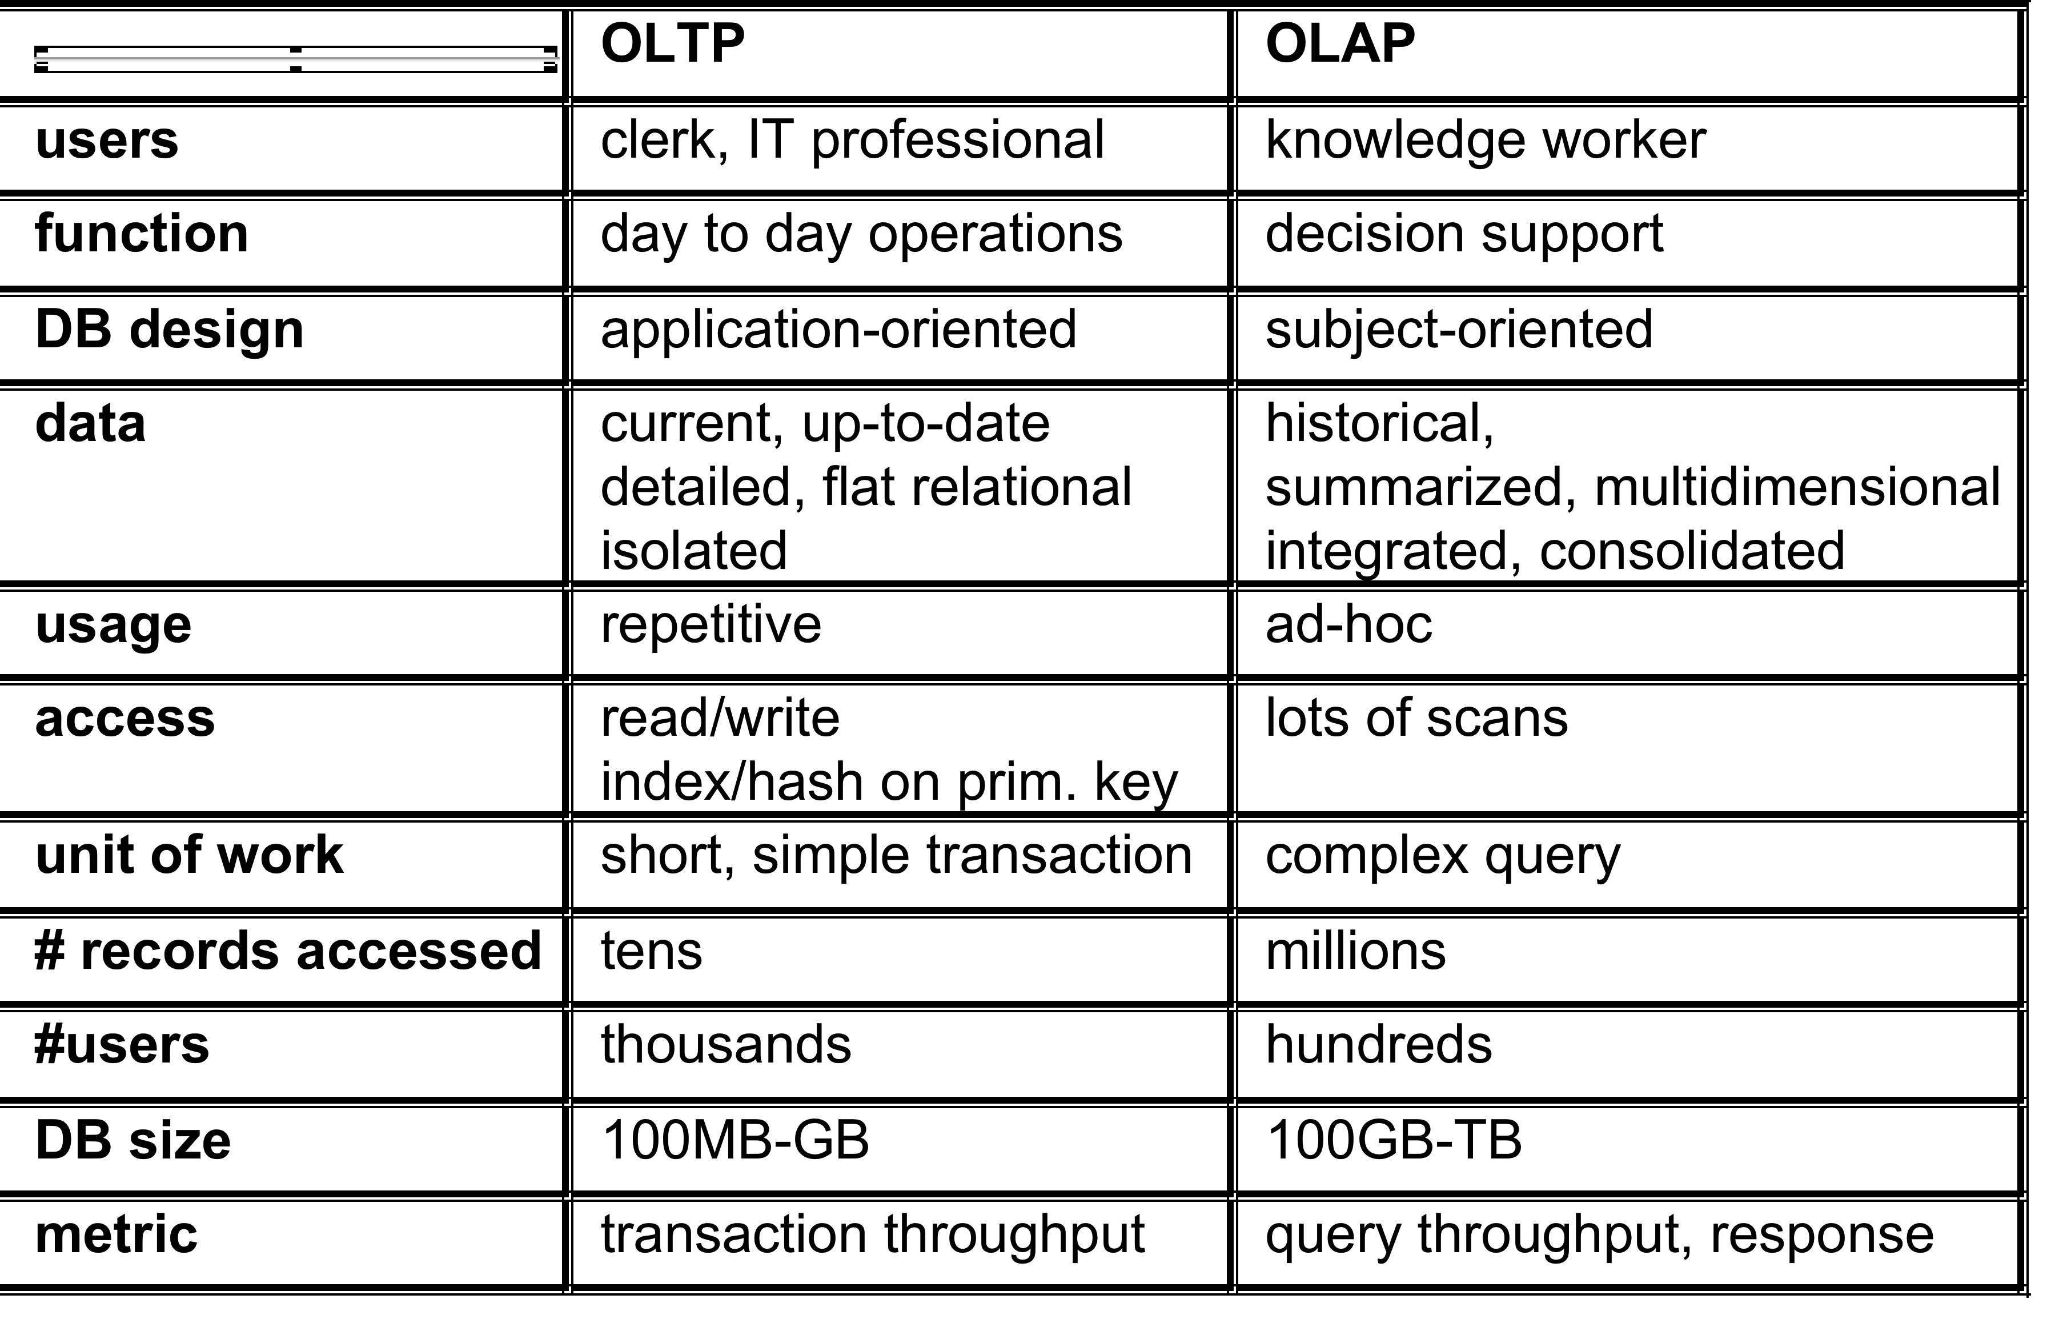
OLTP vs. OLAP

Slide 11
Why Separate Data Warehouse?
High performance for both systems
  DBMS— tuned for OLTP
    access methods, indexing, concurrency control, recovery
  Warehouse—tuned for OLAP
    complex OLAP queries, multidimensional view, consolidation
Different functions and different data
  Missing data: Decision support requires historical data which operational DBs do not typically maintain
  Data consolidation: DS requires consolidation (aggregation, summarisation) of data from heterogeneous sources
  Data quality: different sources typically use inconsistent data representations, codes and formats which have to be reconciled

